Slide 1
GENERAL PHYSICAL EXAMINATION AND VITAL SIGNS

Slide 2
GENERAL PHYSICAL EXAMINATION
ANEMIA
JAUNDICE
CYANOSIS
CLUBBING
LYMPHADENOPATHY
EDEMA

Slide 3
VITAL SIGNS
PULSE
BLOOD PRESSURE
RESPIRATORY RATE
TEMPERATURE

Slide 4
PULSE
The beat of the heart felt at an artery as A wave of blood passes through the artery
The pulse rate is affected by many factors – age, fever, exercise, fear. Anger, anxiety, excitement, heat, position, and pain.

Slide 5
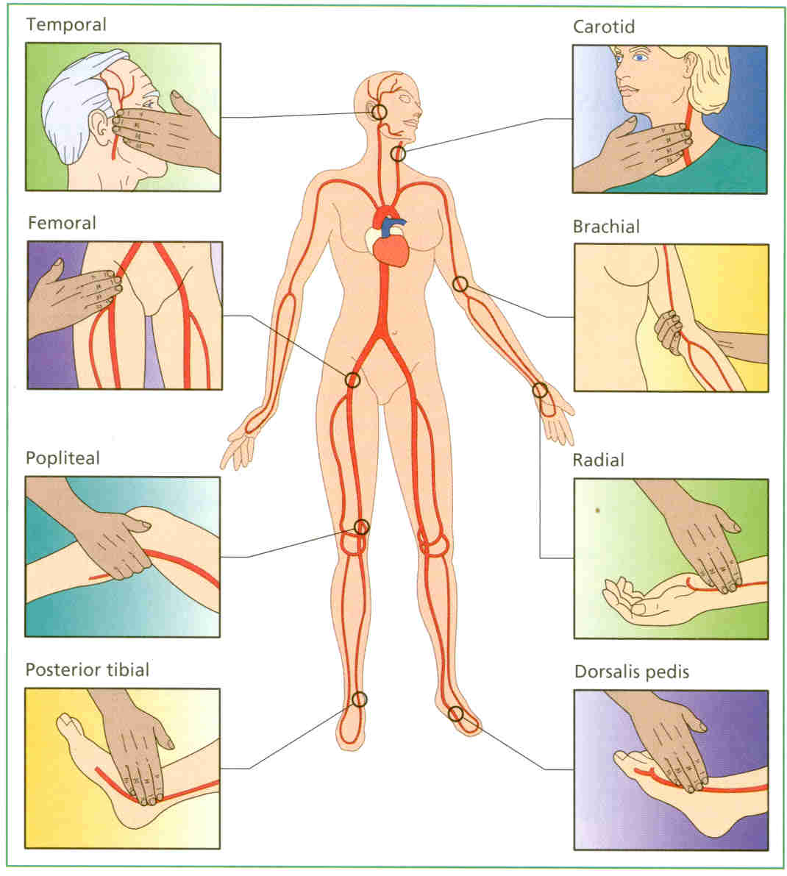

Slide 6
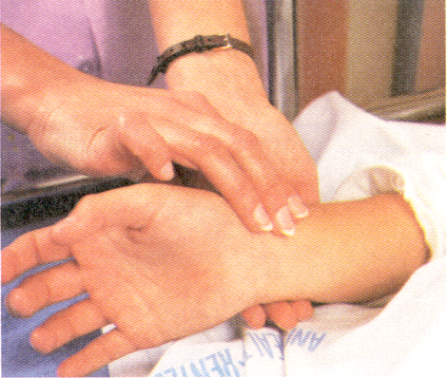
TECHNIQUE
Feel over BONY area
DO NOT use thumb
Use 2-3 fingers
DO NOT squeeze
Count 30 seconds if regular x 2
Note Rate, Rhythm, Quality
If irregular, count for 1 full minute or take apical pulse for 1 minute.

Slide 7
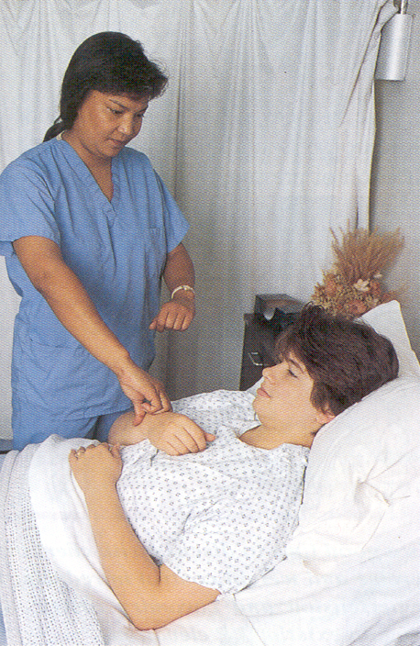
Respiratory rate
If respirations regular, count respirations for 30 seconds and multiply times 2.
If irregular, less than 12 or greater than 20, count for 1 full minute.
Quality of respirations- assess movement of chest or abdominal wall- deep, normal, shallow
Deep- full expansion of lungs
Normal- normal
Shallow- limited expansion of lungs

Slide 8
Blood Pressure
Force exerted on the walls of the artery. Created by the pulsing blood under pressure of the heart.
Systolic- Peak and maximum pressure of ejection of blood from the heart into the aorta. This is the top number.
Diastolic- The minimal pressure remaining the heart when the heart relaxes. This is the bottom number.
Recorded as a ratio Ex. 120/80
Pulse pressure- Difference between the systolic and diastolic. ( 120/80 – Pulse pressure 40)

Slide 9
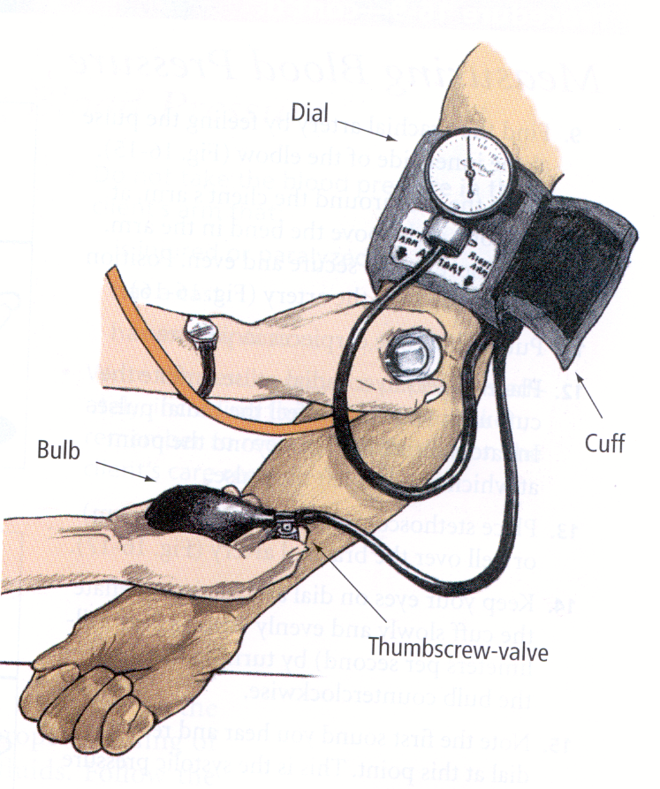
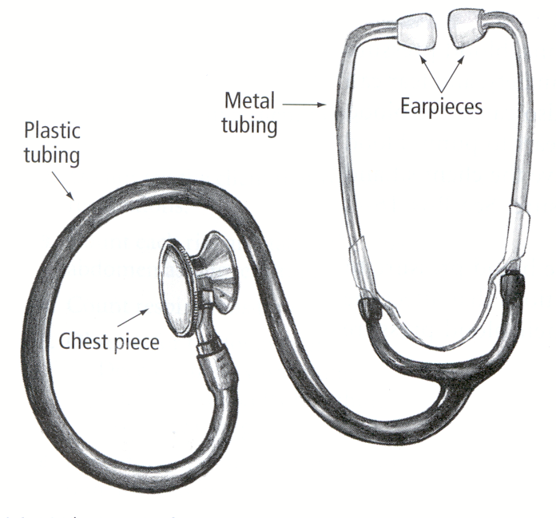
EQUIPMENT FOR BP

Slide 10
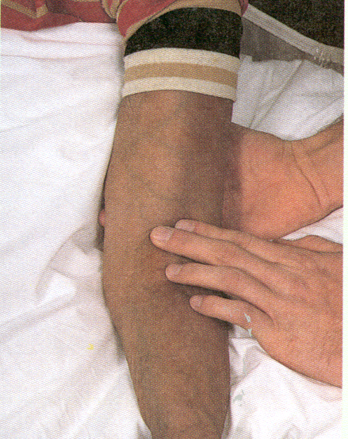
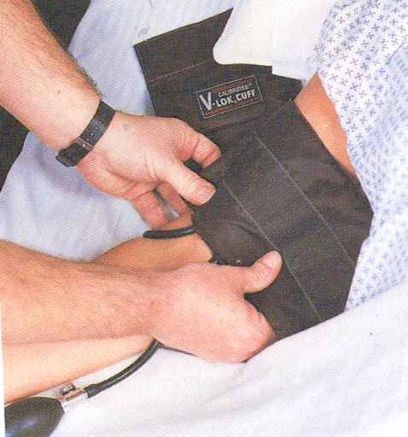
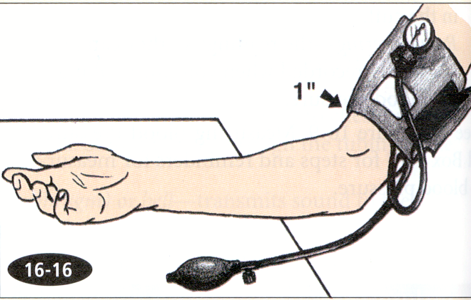
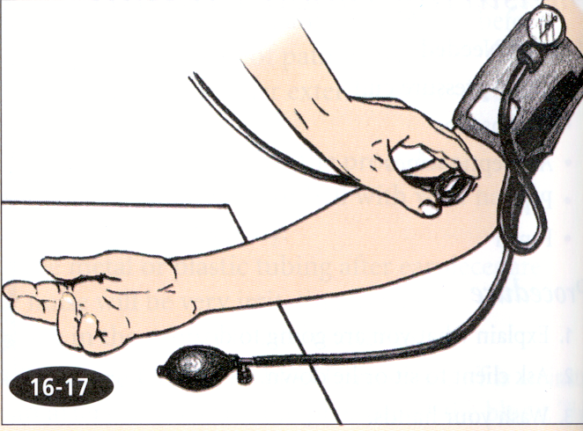
MEASURING BP

Slide 11
TEMP or FEVER?
TEMPERATURE—the measurement of heat in the body
FEVER—the measurement of heat in the body that is above normal for the individual

Slide 12
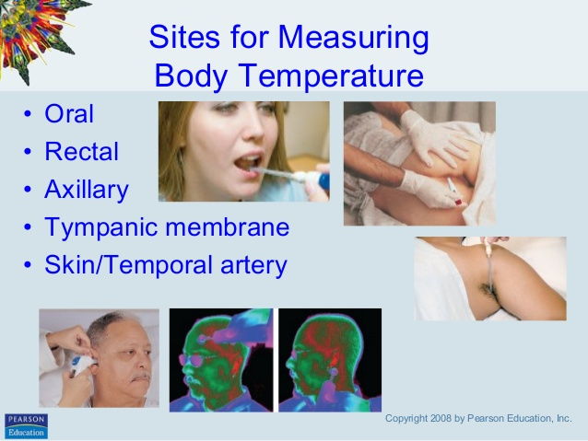

Slide 13
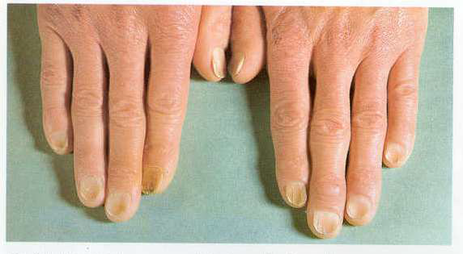
Anaemia
Pallor is a pale color of the skin and mucous membrane due to reduce in amount of oxyhemoglobin

Slide 14
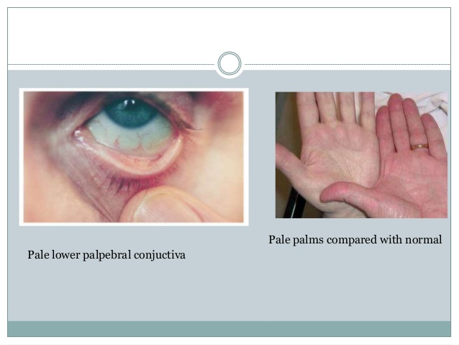
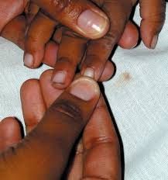
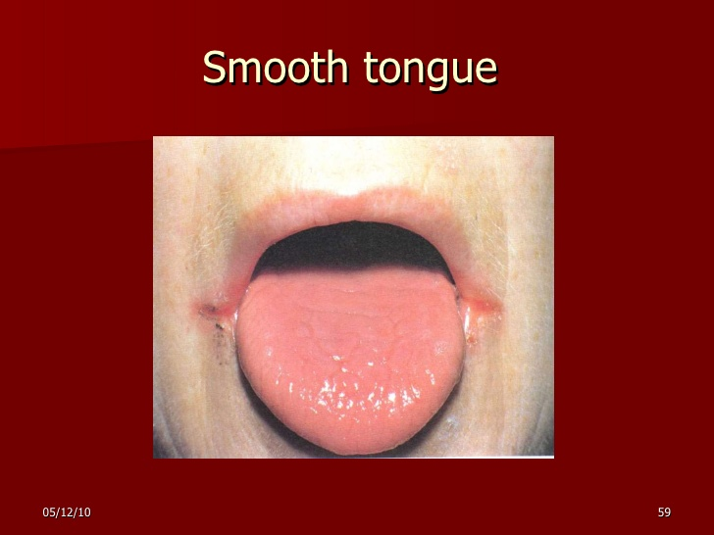
Anaemia examination sites

Slide 15
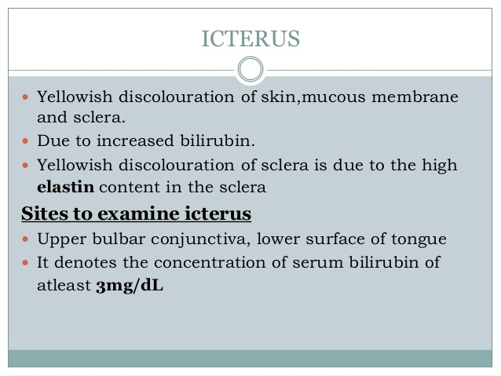
Jaundice

Slide 16
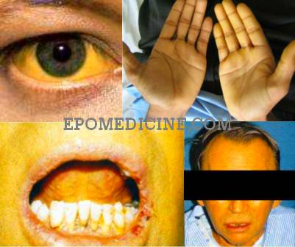
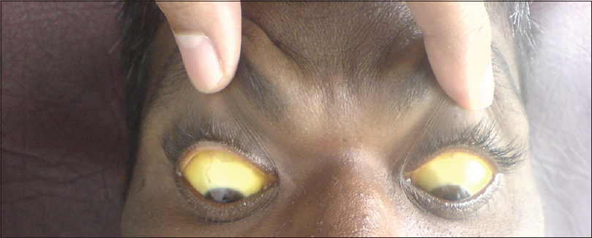

Slide 17
Cyanosis
Bluish discolouration of skin and mucus membrane caused by presence of excessive amount of reduced hemoglobin in capillary blood
1. central cyanosis
2. peripheral cyanosis
3. Mixed

Slide 18
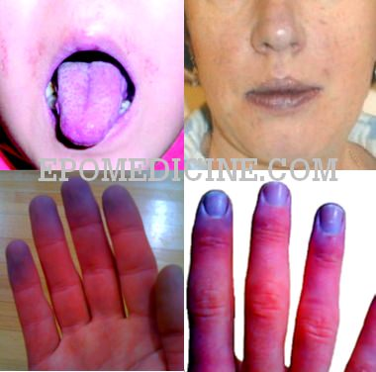

Slide 19
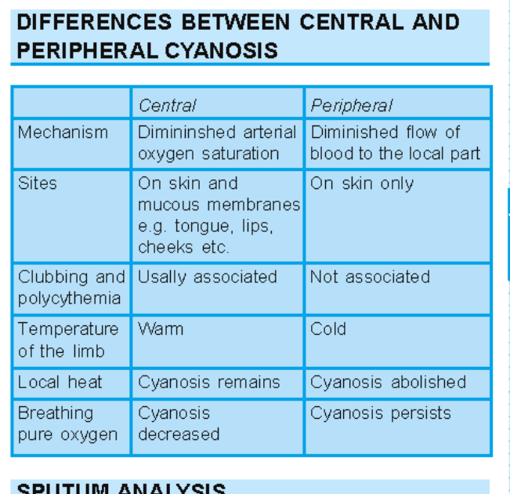

Slide 20
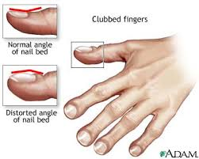
Clubbing
Clubbing is the bulbous uniform swelling ot the terminal phalanx of a digit with subsequent loss of the normal angle between the nail and nail bed

Slide 21
GRADES OF CLUBBING
Grade I: softness of nail bed
Grade II: obliteration of Lovibond angle
Grade III: increased curvature of nail-parrot beak/drumstick appearance
Grade IV: hypertrophic osteoarthropathy-painful swelling of distal diaphysis of long bones due to subperiosteal new bone formation(at wrist, ankle, etc)

Slide 22
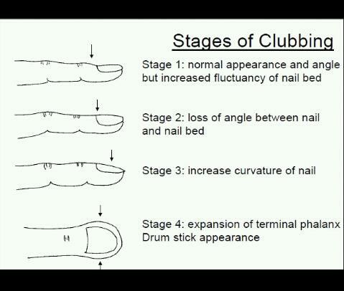

Slide 23
Lymph nodes
Preauricular
Postauricular
Submental
Submaxillary
Occipital
Cervical
Supraclavicular
Axillary
Epitrochlear
inguinal

Slide 24
Look for….
location
size
delimination (discrete or matted together)
mobile or fixed
consistency (soft, hard, firm)
tenderness

Slide 25
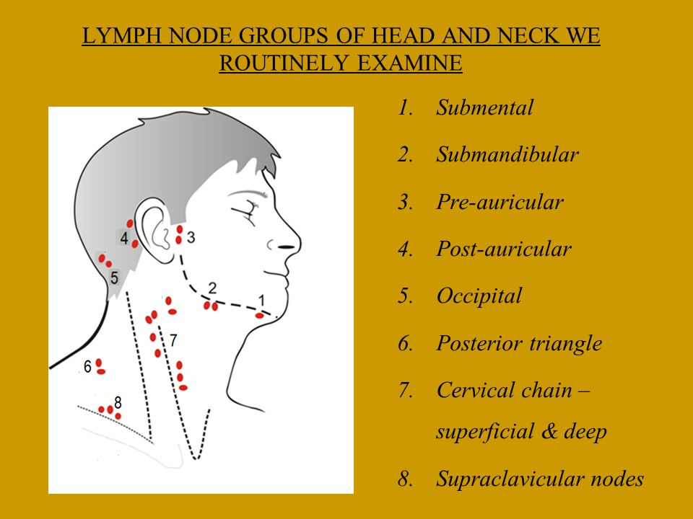
Lymph node lymph nodes in head and neck

Slide 26
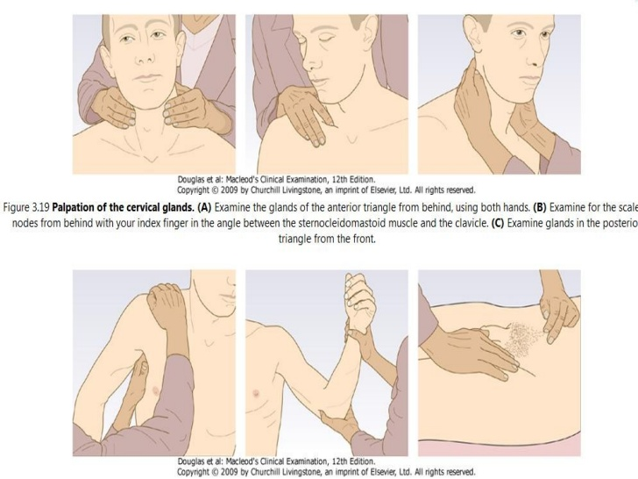

Slide 27
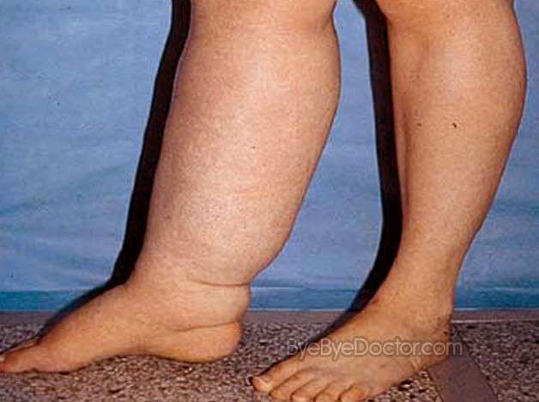
Edema

Slide 28
